Slide 1
Crime Data Analysis
City of Los Angeles(2012 - 2015)
Prof: Dr. Alex Wu
By: Abhinaya Vijaykumar (91098)
Kshama Jwala Kumar (91987)
Priyanka Gopalakrishna (90807)

Slide 2
Crime Analysis
What is it?
Who uses it?
What information does it provide?
What analysis have we done?
What conclusions can we draw?
Are there any trends and patterns?
Are there any limitations?
What is the future scope?

Slide 3
Introduction
In California, Los Angeles has a crime rate that is higher than 75% of the state's cities and towns of all sizes.
Crime data analysis is important to understand crime patterns.
Crime prediction helps in crime prevention.
Data is analysed from Jan 2011 to mid of Nov 2015.
In fact, in Los Angeles the possibility of theft is one in 240.

Slide 4
Benefits of Crime Analysis
Crime Analysis provides a proactive approach to security and law enforcement for the implementation of new crime prevention techniques.
Analyze crime to take advantage of the abundance of information existing in law enforcement agencies, criminal justice system and public domain.
Analyze crime to maximize the use of limited law enforcement resources.
Analyze crime to be proactive in detecting and preventing crime.

Slide 5
Steps Involved
Begins with looking at the frequency of crime occurrences as compared to another period.
- This can indicate a rise or decrease in crime.
After initial statistical analysis, the search for patterns begin.
- patterns based time, area, type of crime, etc, can lead to potential solutions.

Slide 6
Understanding the Crime Dataset
'data.frame': 935258 obs. of 14 variables:
$ Date.Rptd : chr "03/20/2013" "03/10/2013" "12/18/2013" "10/18/2013" ...
$ DR.NO : int 132007717 130608787 131820260 131817514 130510483 131213618 140119745 142015263 140119671 140915108 ...
$ DATE.OCC : chr "03/20/2013" "03/10/2013" "12/18/2013" "10/18/2013" ...
$ TIME.OCC : int 2015 445 745 1730 2000 1145 2240 1337 1945 825 ...
$ AREA : int 20 6 18 18 5 12 1 20 1 9 ...
$ AREA.NAME : chr "Olympic" "Hollywood" "Southeast" "Southeast" ...
$ RD : int 2004 635 1839 1827 507 1211 111 2023 111 933 ...
$ Crm.Cd : int 997 997 997 997 440 997 310 901 210 901 ...
$ CrmCd.Desc : chr "TRAFFIC DR #" "TRAFFIC DR #" "TRAFFIC DR #" "TRAFFIC DR #" ...
$ Status : chr "UNK" "UNK" "UNK" "UNK" ...
$ Status.Desc : chr "Unknown" "Unknown" "Unknown" "Unknown" ...
$ LOCATION : chr "OXFORD" "ODIN ST" " 105TH ST" " 101ST ST" ...
$ Cross.Street: chr " OAKWOOD" " CAHUENGA BL" "CROESUS AV" " JUNIPER ST" ...
$ Location.1 : chr "(34.0776, -118.308)" "(34.1113, -118.3336)" "(33.9406, -118.2338)" "(33.9449, -118.2332)" ...
Data published by: data.lacity.org
Data Owner: LAPD
Number of Files: 1
File Size: 152 MB
File Format – CSV (Comma Separated Values)
Number of Rows: 935K
Number of Columns: 14
Each row is an instance of crime (a case).

Slide 7
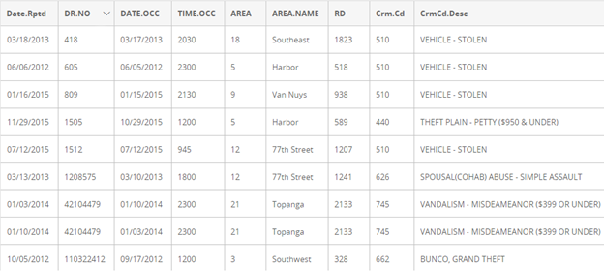
Data Source: https://catalog.data.gov/dataset/crimes-2012-2015/resource/a2369c45-fcdb-4819-b3fc-979c7b737aed

Slide 8
Variables Used
Date Occurred | Which day crime has been reported and updated in the csv. Unfortunately, some of these incident numbers are duplicated.
Area Name | All areas in LA
Crime Category | Category of the crime. Eg: Theft, Fraud, and so on. This is to combine similar crimes to keep the categories handful
Time | Hour and Minute of crime occurrence (hhmm)

Slide 9
Data Pre-processing
Checking for missing values
Removing duplicate values (based on DR.NO)
Date Manipulation (mm/dd/yyyy to month, day and year)
Time Manipulation (hh:mm to hour and min)
Grouping crimes from 158 categories into 9 categories
Normalization
Adding a count variable

Slide 10
Analysis
Percentage contribution of each type of time to the total numbers.
Aggregation of crime count for each crime category for each year
Comparison of total crime occurrences for every month for every year.
Calculation of crime count for every area in LA for every year and comparing the values for all the years.
Monthly crime count for every crime category for all four years
Detailed analysis of Theft - based on hour of the day

Slide 11
Findings and Interpretation
Crime Category | Count
Assault | 153150
Burglary | 152222
Crime against children | 11141
Fraud | 10434
Sex | 10259
Theft | 270218
Traffic | 166854
Vandalism | 74616
Other | 84306
Year | Crime Count
2012 | 238116
2013 | 233141
2014 | 234964
2015 | 226979

Slide 12
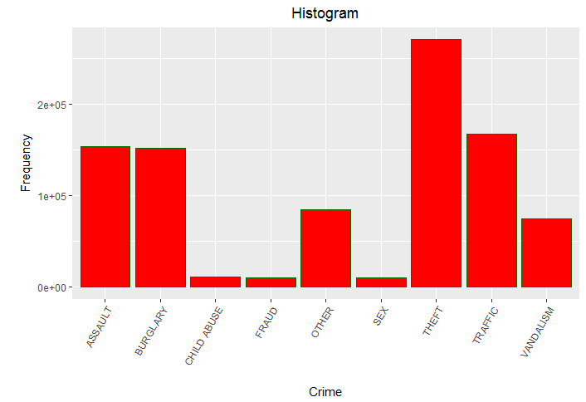

Slide 13
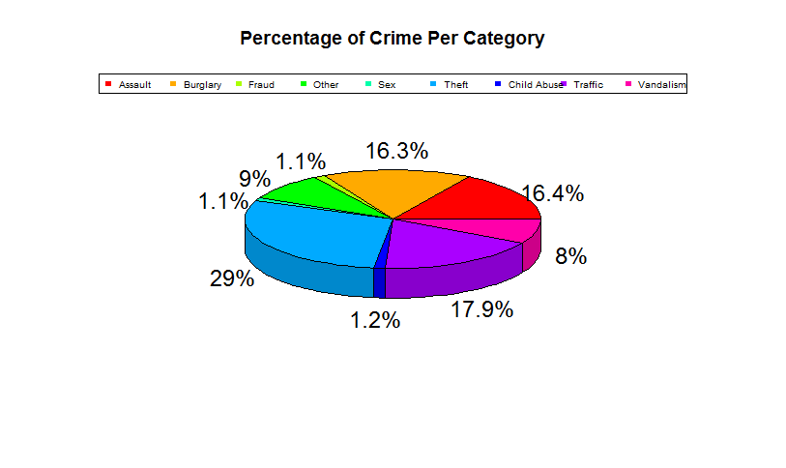

Slide 14
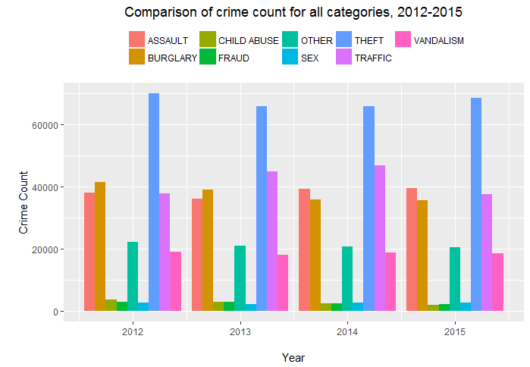

Slide 15
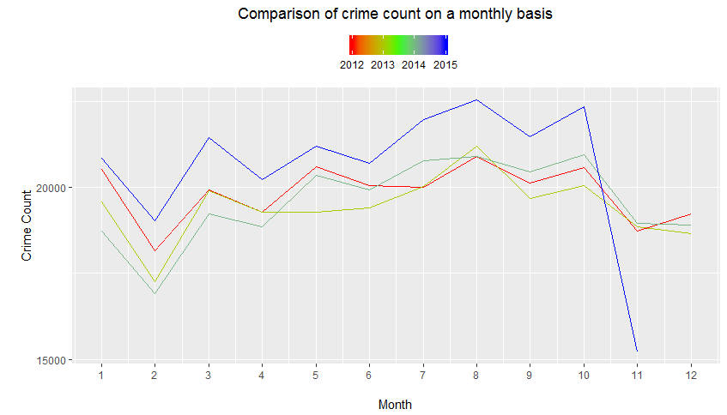

Slide 16
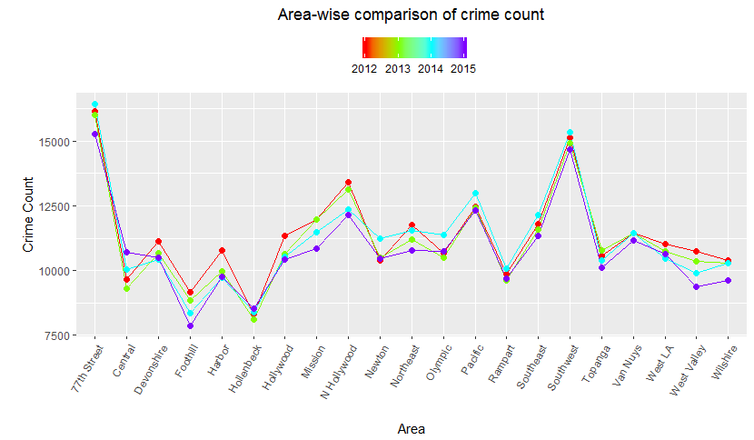

Slide 17
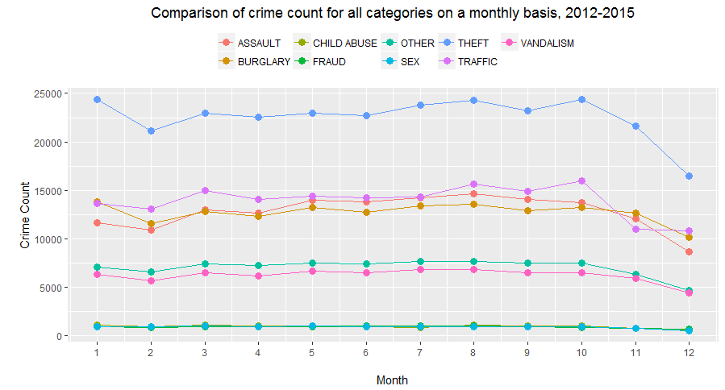

Slide 18
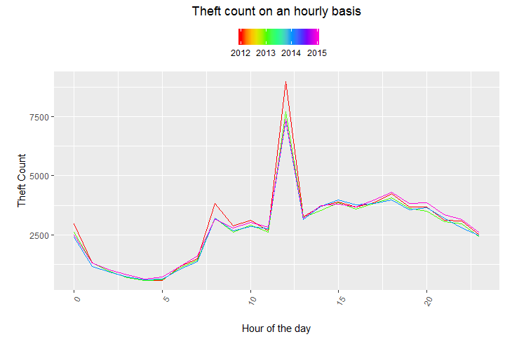

Slide 19
Discussion
Crime rate is higher in the heart of the city than in other areas in LA.
Crime rate is higher in the year 2012. A slight decline has been observed in 2013 and 2014.
2015 has seen a steady increase in crime (our dataset is only until november)
Crime rate is highest in 77th street for all the four years closely followed by Southwest and N Hollywood.
Foothill and Hollenbeck have the lowest crime rates in LA.
Theft contributes to 29% of the total crime and is by far the most prominent crime from 2012 to 2015.

Slide 20
Discussion cntd...
Traffic related crimes, burglary and assault are the other significant crime categories
A steady increase in crime rates is observed from July to August.
August and November have visibly higher crime rates compared to the other months.
Theft occurrences are higher around noon and between 5pm and 7pm.

Slide 21
Conclusion
The process of developing goals and objectives attempts to reflect more input from the community as well as from the City government.
Our data analysis improves better coordination and cooperation between patrol and detective functions.
In future, we can use the location data (lat/long) and map crime hotspots using GIS.
Predictive analysis can be done using logistic regression models.
Limitation:
Data is available only until mid of November for 2015.

Slide 22
References
http://www.statmethods.net/advgraphs/ggplot2.html
https://www.r-bloggers.com/crime-analysis-denver-part-1/
https://irgn452.files.wordpress.com/2016/03/3-s2-0-b9780124115118000141-main.pdf
http://www.treselle.com/blog/sfo-city-crime-analysis-with-r/

Slide 23

Thank you!!

